Slide 1
Grainger
Future Vacant and Void Process
Project Kick-Off Meeting

Slide 2
Project Teams
Timelines & Billing Milestones
Agile Delivery Approach
Project Processes

Slide 3
Vision and Objectives
Project Vision :
A centralized, standardized void workflow that tracks the end-to-end void progress, minimizes delays, and provides visibility into upcoming work, expected timelines & responsibilities.
The solution will be delivered in increments, providing tangible business value on a regular basis.
Key Objectives :
Measure Targets, Timeframes & KPIs
Visibility into Progress, Delays & Forecasted Completion
Visibility into Team Workload
Standardise Process while Allowing for Flexibility
Automate Notifications to Internal Teams
Move Towards Single View of Customer & Property
Clear Responsibility

Slide 4

Proposed Success Criteria
User adoption of single process within Salesforce
Reduced turnaround time per void
Visibility into number of voids per employee
Reduced number of onsite visits per void

Slide 5
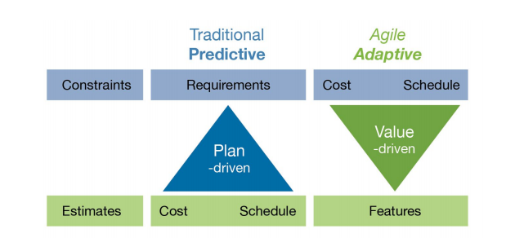
Our Agile Manifesto
We follow an agile methodology, continuously uncovering better ways of developing software by doing it and helping others do it. Through this work we have come to value:
Individuals and interactions over processes and tools
Working software over comprehensive documentation
Customer collaboration over contract negotiation
Responding to change over following a plan
In simple terms, while there is value in the items on the right, we value the items on the left more.

Slide 6
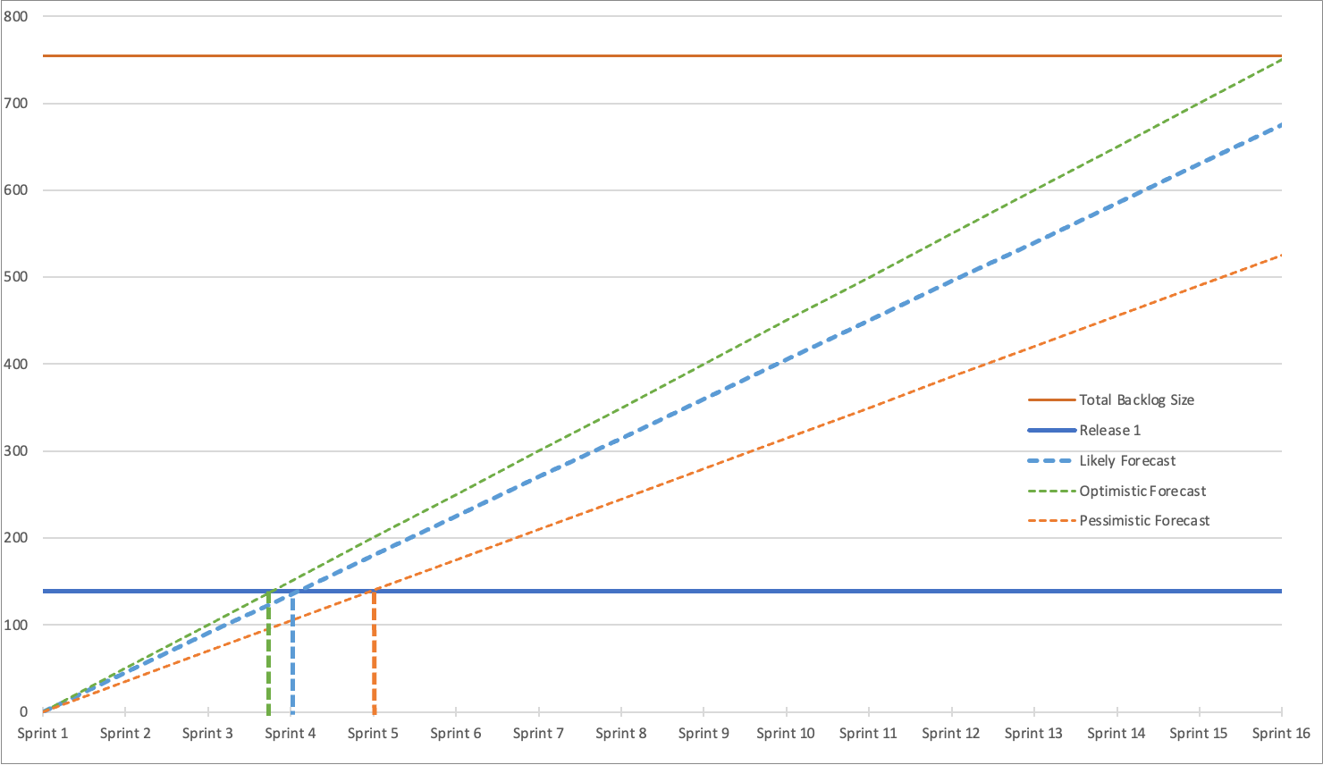
Release 1 Forecast
Likely: 4 sprints = 12 weeks

Slide 7



Agile Delivery Approach
Iterative delivery is achieved through a series of 3-week sprints
Process Improvement
Sprint Retrospective
Open Box Activity
Grainger Activity
Joint Activity
Daily Stand-up
3-week Sprint
Sprint Planning
Sprint Demo
Testing
Product Increment
Sprint Backlog
Product Backlog
Backlog Refinement & Prioritisation
Backlog Refinement
Feedback

Slide 8




Project Teams
Open Box Delivery Team
GRAINGER Stakeholders
Salesforce Architect
Sam
Business Analyst
Nikki
Developers
Anjali
Dillan
Matt
Quality Assurance
Khonani
Project Manager
Shaun
Project Lead
Jon
Project Manager
Yvonne
Product Owner
Jacob
Salesforce Technical Team
Jaic (apps & Integrations Lead)
Saji (Salesforce & MyGrainger)
SMEs
Anita
Others called on as needed

Slide 9




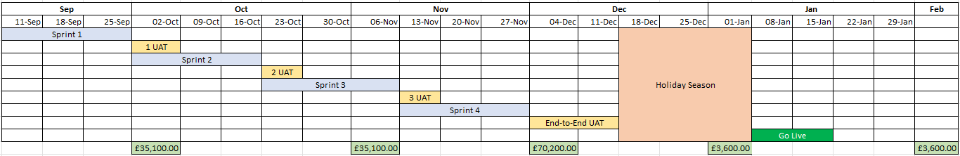
Timelines & Billing Milestones
Release 1
4 sprints
3 months
Effort
Duration
Oct
Jan
CanDo!
Go-Live
Notes:
CanDO!
- October is a little later than anticipated.
Something to bear in mind when assessing project milestones and impact on go-live
Go-Live early next year. December is our summer break so a lot of the team will be out

Slide 10


Project Processes
Sprint Ceremonies
Stand up – twice a week (15 min)
Refinement – once a week (1 hr)
Demo & Planning 2 – once every 3 weeks (1 hr)
Documentation
Confluence
Jira
Project Charter
Weekly PM Report
Definitions
Definition of Ready
Definition of Done
Bugs vs Additional Scope
Notes:
Sprint ceremonies – include core project team?
Jira – document and update details on the jira user story

Slide 11
Next Steps
Sign off Sprint 1 user stories for start of sprint 1 on 11th September
Confirm targeted release 1 go-live date
Finalise project charter
Notes:
Sprint ceremonies – include core project team?
Jira – document and update details on the jira user story

Slide 12
Thank You

